Slide 1
Lung Cancer Detection Using CNNs
A Project Utilizing CNN and VGG16 for Lung Cancer Detection

Slide 2
overview
Understanding and building Convolutional Neural Networks (CNNs) for medical image classification.
Applying transfer learning with VGG16 to enhance classification accuracy using a pre-trained model.

Slide 3
Dataset Overview
The IQ-OTHNCCD dataset was used, containing three classes:
- Benign: 120 cases
- Malignant: 561 cases
- Normal: 416 cases

Slide 4
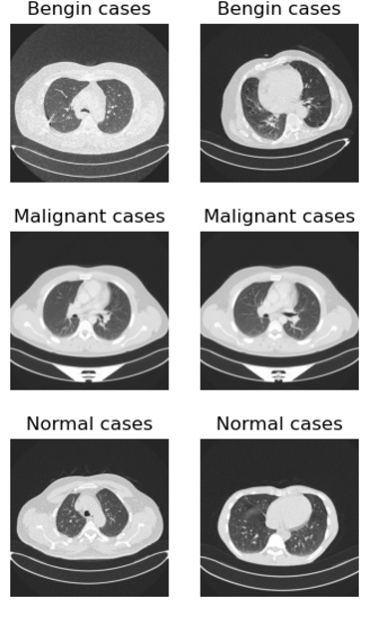

Slide 5
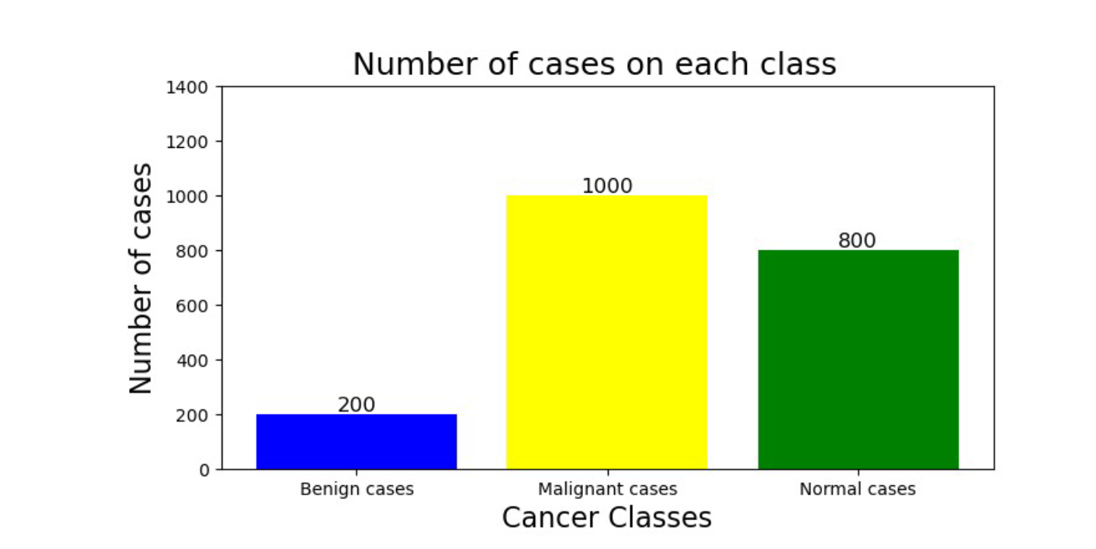

Slide 6
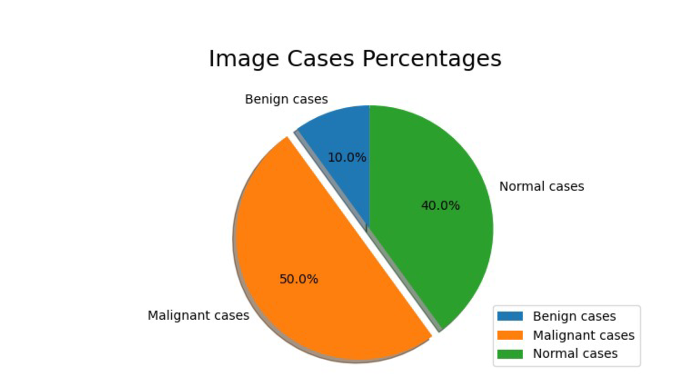
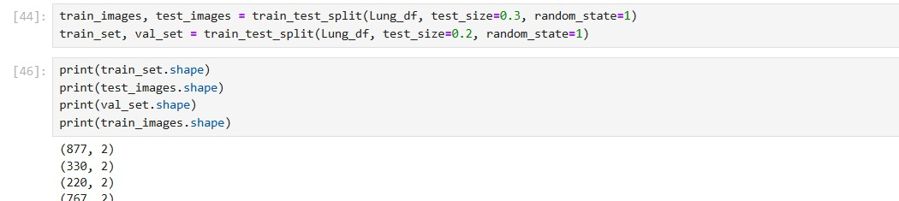

Slide 7
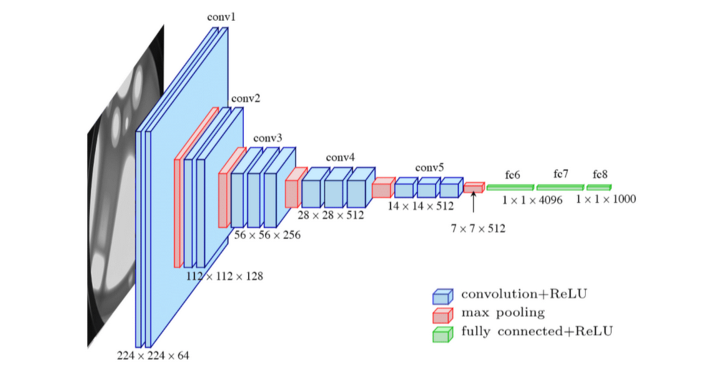

Slide 8
CNN Model Architecture
Input Layer: Handles the input images (e.g., dimensions and preprocessing requirements).
Convolutional Layers (Conv2D):Extracts spatial features using varying kernel sizes.
Multiple layers for deeper feature extraction.
Batch Normalization: Normalizes outputs of each layer to stabilize and accelerate training.
MaxPooling Layers:Reduces spatial dimensions and computational complexity.
Retains significant features by pooling operations.
Dense (Fully Connected) Layers:Flattens feature maps and connects to the output.
Integrates learned features for classification

Slide 9
Dropout Regularization: Reduces overfitting by randomly deactivating nodes during training.
Output Layer: Final layer with softmax activation for multi-class classification.
Optimizer: Stochastic Gradient Descent (SGD) for better convergence.
Loss Function: Categorical Crossentropy.
Training Details: Trained over multiple epochs to minimize loss and improve accuracy.

Slide 10
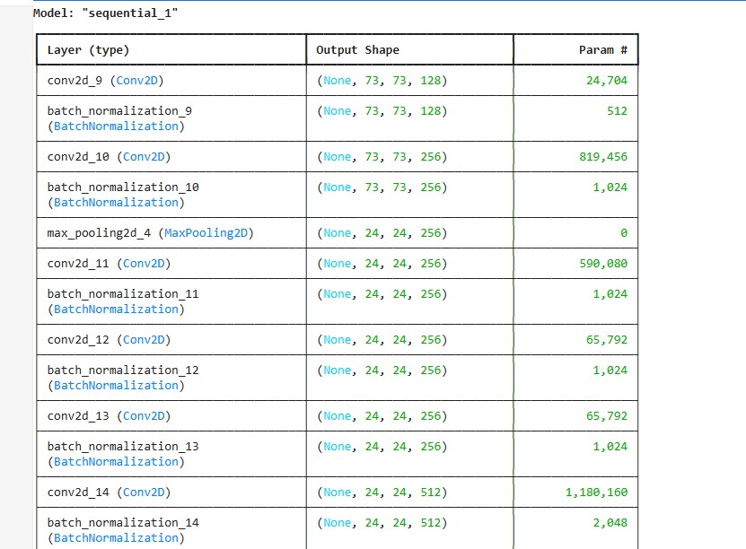
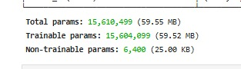
Conv2D Model

Slide 11
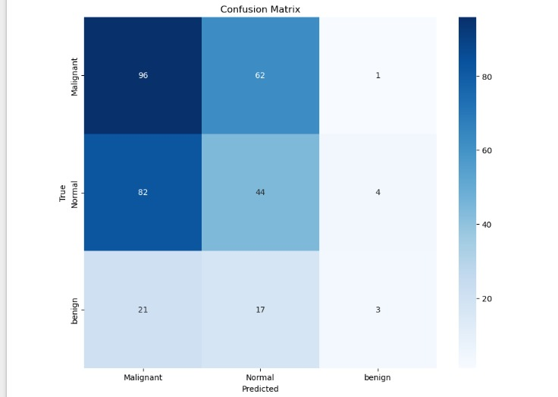
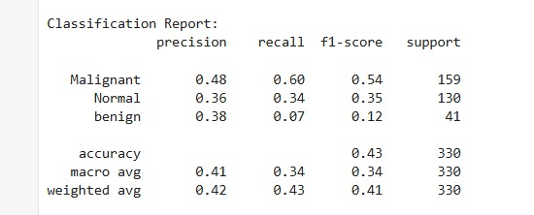

Slide 12
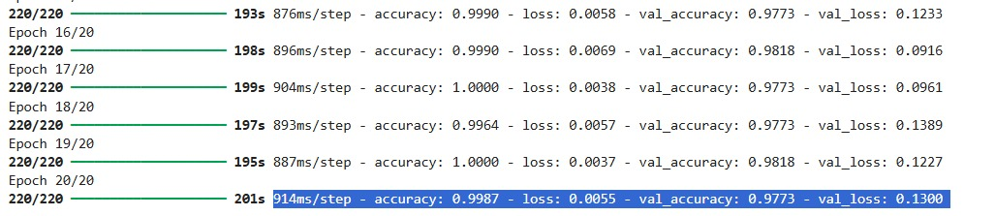
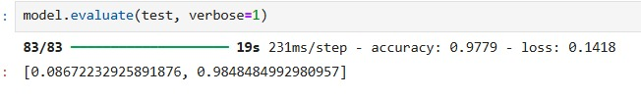

Slide 13
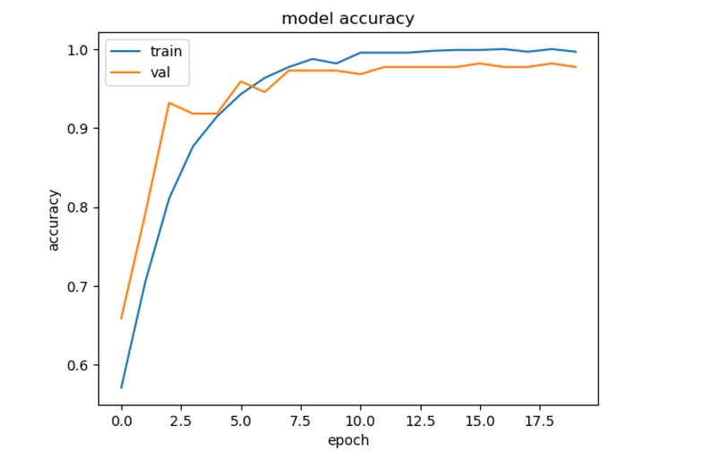
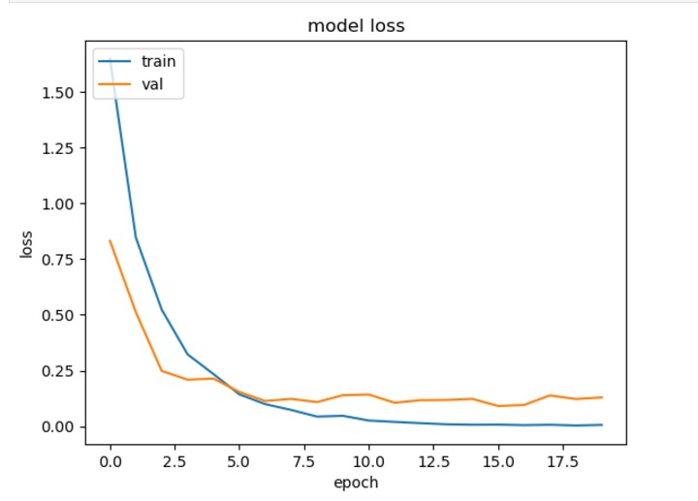

Slide 14
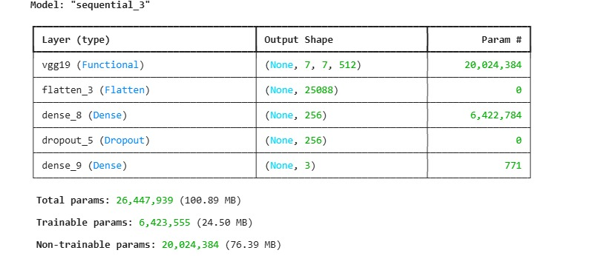
VGG19 Model

Slide 15
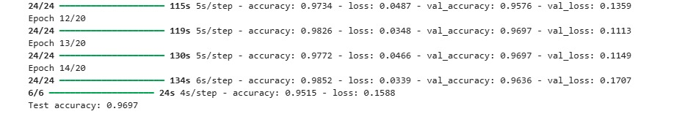
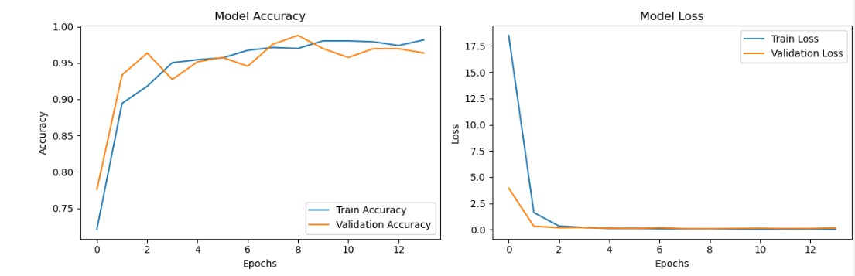

Slide 16
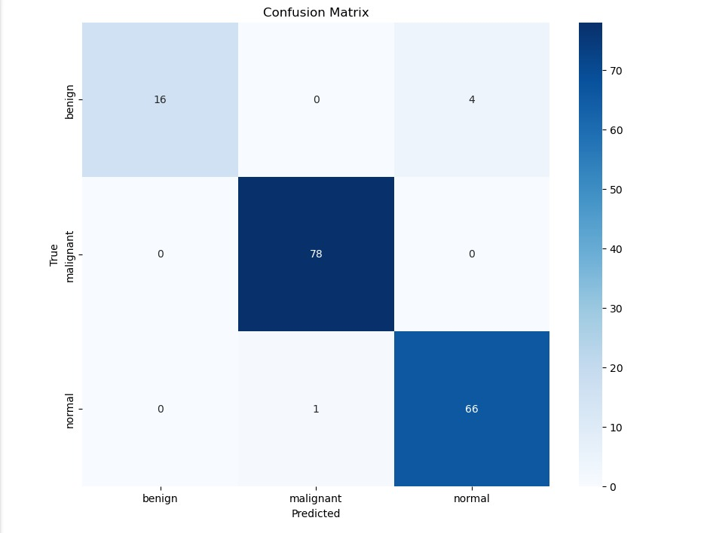
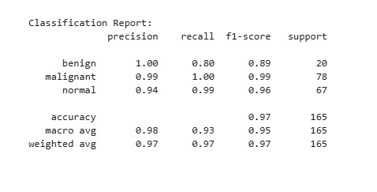

Slide 17
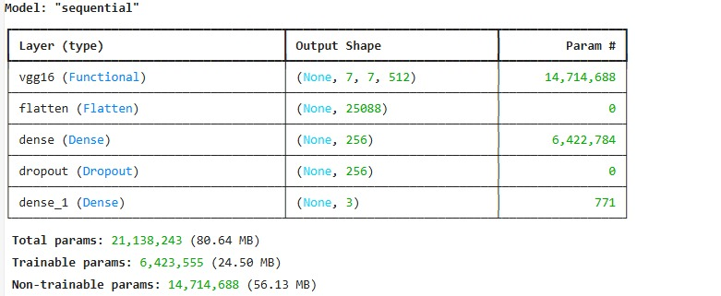
Transfer Learning Model

Slide 18
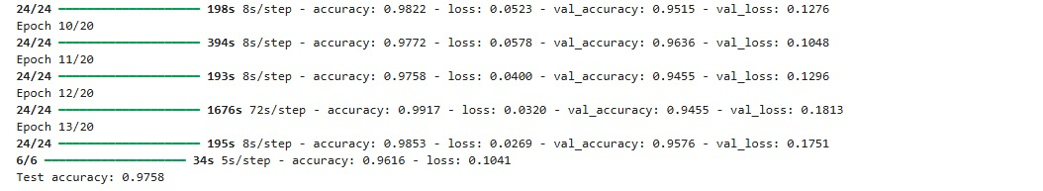
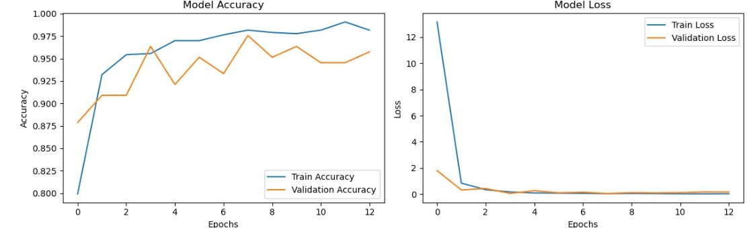

Slide 19
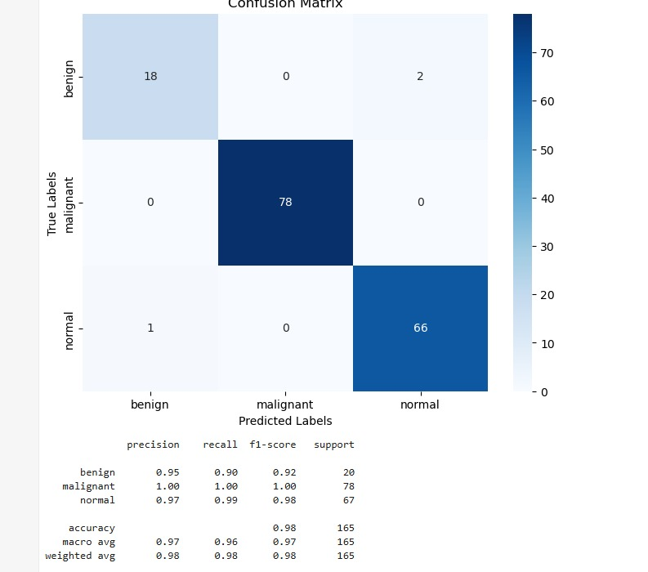

Slide 20
Conv2D Model
Architecture: Includes Conv2D layers with varying kernel sizes, Batch Normalization, MaxPooling, and Dense layers with dropout.
Optimizer: SGD.
Loss Function: Categorical Crossentropy.
Performance: While specific metrics for the Conv2D model aren't explicitly mentioned, it forms the foundational CNN architecture.
Advantages: Custom-built for the dataset. Allows fine-grained control over architecture. Good for learning image patterns from scratch.
Disadvantages: Requires more data and computation to achieve high performance. Risk of overfitting, especially on smaller datasets like IQ-OTHNCCD.

Slide 21
VGG16
Method: Pre-trained VGG16 model was fine-tuned:
Feature extraction layers frozen.
Custom dense layers added.
Performance:
Test accuracy: 98.1%.
High precision, recall, and F1-score across all classes.
Minimal misclassifications based on the confusion matrix.
Notes:
"Our primary model, VGG16, is a pre-trained CNN architecture widely used for image classification. VGG16 is known for its 16 layers, including convolutional, pooling, and fully connected layers, making it a reliable model for image classification tasks.
In this project, we fine-tuned it by freezing the feature extraction layers and adding custom dense layers to classify lung cancer cases into benign, malignant, and normal categories.""The model achieved a test accuracy of 98.1%, with high precision, recall, and F1-scores across all classes."

Slide 22
Advantages: Leverages pre-trained features from a large dataset like ImageNet, which helps even with smaller datasets.
Achieved the best reported accuracy and robust performance in this project.
Disadvantages: Less customizable compared to building models from scratch.
Pre-trained models may introduce biases from the original training dataset.
Notes:
Advantages:
Transfer Learning: The model benefits from knowledge gained from ImageNet dataset, making it effective even with smaller datasets.
Proven Robustness: It achieved the highest accuracy among all models tested in this project.
Disadvantages:
Limited Customization: Pre-trained models restrict architectural changes.
Potential Bias: It may inherit biases from the ImageNet dataset.

Slide 23
VGG19 Model
VGG19 is a deeper CNN architecture than VGG16, comprising 19 layers.
likely tested for comparison but its specific results were not highlighted in the slides.
Advantages: Proven architecture for image classification tasks. Deeper than basic Conv2D, potentially capturing more complex features.
Disadvantages: Computationally expensive due to its depth. Requires larger datasets or significant regularization to avoid overfitting.
Notes:
"We also explored VGG19, a deeper architecture with 19 layers. While capable of capturing more complex features, it is computationally expensive and at higher risk of overfitting. As a result, VGG19 did not surpass VGG16 in our tests."

Slide 24
BEST MODEL
The Transfer Learning model using VGG16 is the best choice based on:
Highest test accuracy (98.1%).
High precision, recall, and F1-score.
Robustness with minimal misclassifications, making it ideal for medical image classification.
Notes:
"VGG16 proved to be the best-performing model, offering the highest accuracy and robustness. It had minimal misclassifications, making it ideal for medical applications like lung cancer detection."

Slide 25
Research Questions
How does the performance of CNN models compare to traditional diagnostic methods in lung cancer detection?
The project evaluates the performance of CNN models like VGG16 and VGG19 in diagnosing lung cancer compared to traditional diagnostic methods.
What impact could CNN-based lung cancer detection systems have on healthcare accessibility in under-resourced areas?
CNN-based lung cancer detection systems can significantly impact healthcare accessibility in under-resourced areas by addressing critical challenges in diagnosis and treatment.
Can CNNs effectively differentiate between benign and malignant lung nodules in CT scans?
Yes, Convolutional Neural Networks (CNNs) can effectively differentiate between benign and malignant lung nodules in CT scans, given the proper dataset, preprocessing, and model design.
Notes:
"CNNs excel by offering higher accuracy, consistency, and automation compared to traditional methods, which rely heavily on human expertise."
"They also reduce the time and cost of diagnosis, making them an efficient alternative."
2.
"CNNs can democratize access to accurate diagnostics, addressing the shortage of skilled radiologists and expensive diagnostic tools in such areas.""By automating the detection process, these systems make advanced healthcare more accessible and affordable.“
3.
"Yes, CNNs can effectively differentiate between benign and malignant nodules, provided they are trained on properly labeled datasets with adequate preprocessing.""This capability ensures reliable and precise detection, even in complex cases."

Slide 26
Conclusion and References
- CNN and VGG16 effectively classify lung cancer images.
- High accuracy and performance.
Notes:
CNNs, especially VGG16 with transfer learning, are highly effective for lung cancer detection.Offers scalable, reliable, and accurate diagnostics.Potential to improve early detection in under-resourced areas. Highlights how deep learning can transform healthcare diagnostics

